Slide 1
3RD LAKE VICTORIA BASIN DONORS’ CONFERENCE
Round Table Three
Economic and Infrastructure Development
Lily Kisaka

Slide 2
OUTLINE
Introduction
Prospects
Stumbling Blocks
What has been done
Our Plan

Slide 3
INTRODUCTION
Lake Victoria is Africa’s Largest Lake
A key shared resource for the people of East Africa
Population of 40 million
4 million depend on the Lake
A regional Economic growth Zone

Slide 4
PROSPECTS

Slide 5
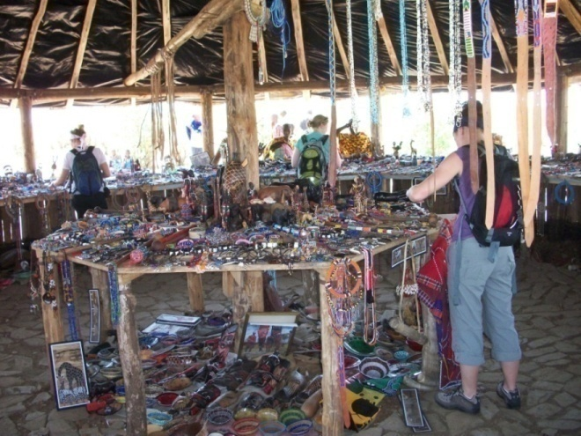
ECONOMIC OPPORTUNITIES
Regional Trade
Facilitating policy and Legal Framework
Potential Market of over 84 Million
Surplus Labour
Potential for investment in several sectors

Slide 6
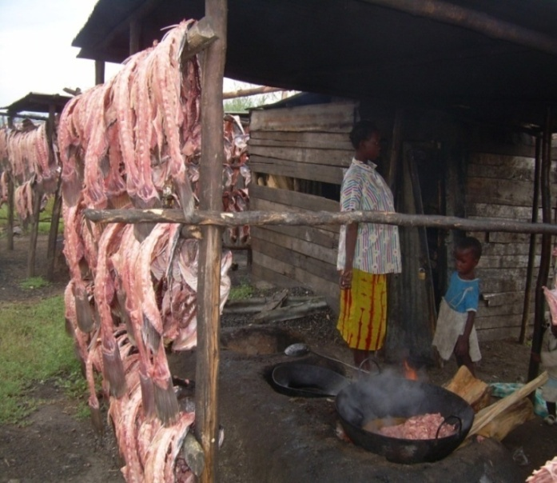
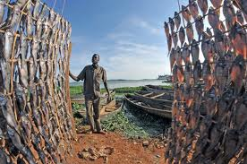
Economic opportunities
Aquaculture
Enormous potential for aquaculture and fish processing
Agriculture
Good agro-climatic zone
Fertile soils

Slide 7
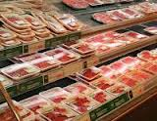
Economic Opportunities
Value Chain
Value addition
Trade and industry

Slide 8
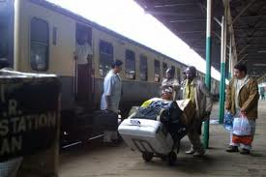
INFRASTRUCTURE
Transport
Important inland waterway
Strategic Connection to other parts of Africa
Served with ports and piers with docking facilities
Connected through all modes of transport to outside markets

Slide 9
STUMBLING BLOCKS

Slide 10
Challenges to Economic Sector
Climate Change
High population
High Poverty levels
Decreasing land sizes
Food insecurity
Decline in capture fisheries
Lack of diversified /alternate livelihood options
Inadequate Information to guide investors
Poor infrastructure and marketing
Insufficient policy level attention
Inadequate institutional and human capacity

Slide 11
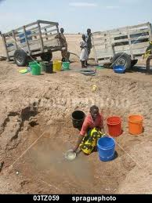
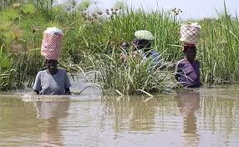
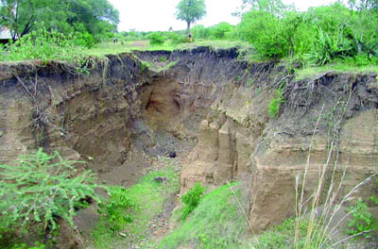
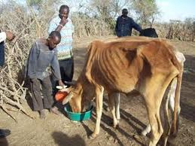
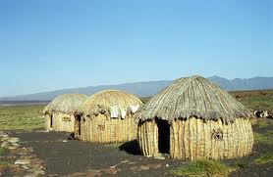
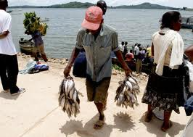
Challenges to livelihood improvement
Soil Erosion
Flooding
Water Scarcity
Drought
Declining capture fish
Post harvest losses

Slide 12
Water Transport Challenges
Lack of Investment in water transport
Search and rescue services are non-existent
Shipping routes not mapped
Outdated navigation charts
Inadequate aids to navigation
Ports
Deteriorated port infrastructure
Silted port approaches
Inadequate cargo handling equipment
Obsolete vessels
Means
Expensive and weak transport and trade links

Slide 13
Challenges to water Transport
Marine transport accidents cause more than 5,000 deaths/yr
Attributed to
Hazardous weather conditions and water currents in the Lake
Strong winds and deep convection characterise weather over the lake
Meteorological Services for marine navigation safety in the basin are
Uncoordinated and inadequate meteorological monitoring network and forecasting system.
Inadequate and Inaccessible weather and climate information

Slide 14
WHAT IS BEING DONE

Slide 15
Interventions already in place
Harmonized Legislation
Common Market Protocol
Climate Change Policy
EAC Agriculture and Rural Development Policy
Lake Victoria Transport Act 2007
Marine Safety Regulations 2011
Surveys and Mapping
Hydro graphic survey of 3 major ports
Preparation of Navigation charts
A Plan for enhancing safety of Navigation by Strengthening Meteorological services on Lake Victoria
Pilot mobile communication network

Slide 16
On –going Intervention
Partner States
Domestication of the Common Market Protocol
Domestication of all regional Policies and regulations
Development of action plans to implement regional strategies
Environment for cooperation
Lake Victoria Environmental Management project II
Survey and mapping of routes
Installation of aids to navigation
Training on oil spills and hazardous waste management
Harmonization of water and fisheries policies
Sustainable land management Strategy

Slide 17
OUR PLAN

Slide 18
Our plan
How
Improved maritime Transport
Income generating opportunities
Appropriate technology transfer
Value addition
Research based decision making
Promote and Create an Enabling environment for
Investment
Employment creation
Increased household Income

Slide 19
Infrastructure Development
012 Maritime communication for safety on LV.docx
013 Development of ports and maritime transport in LV.docx
016 strengthening meteorological services on LV.docx

Slide 20
Economic Development
014 Integrated Aquaculture-Concept.docx
015 Sustainable Climate Smart Agriculture.docx

Slide 21
CONCLUSION

Slide 22
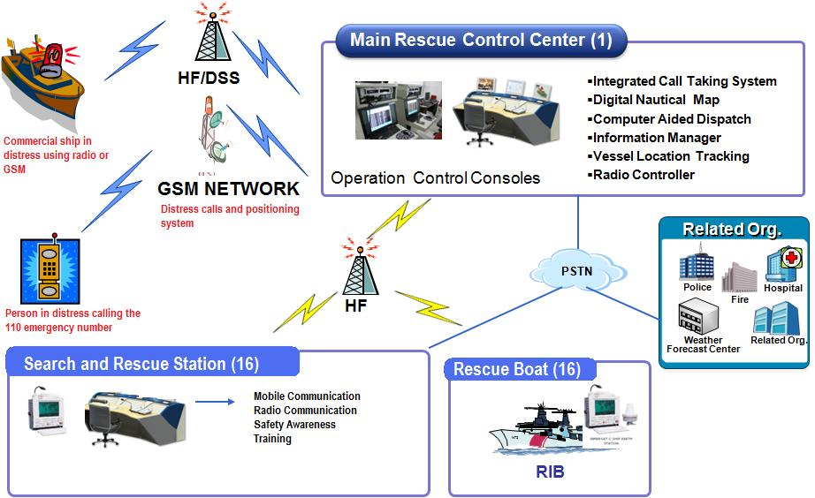
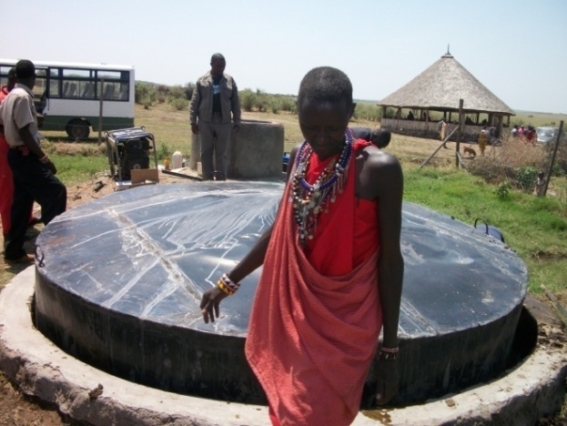
CONCLUSION
Interventions will contribute to Socio-Economic Development in the LVB by
Improving Infrastructure
Improving Livelihoods

Slide 23
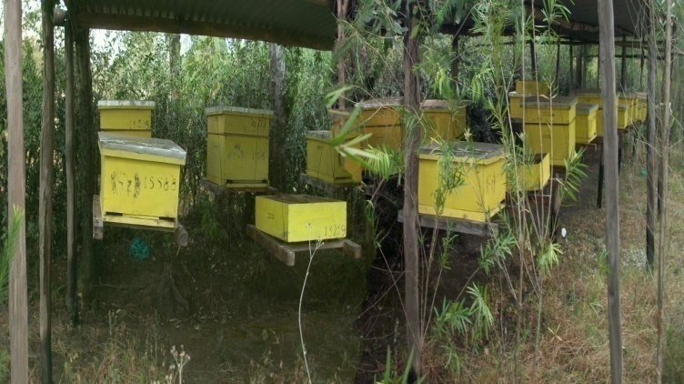
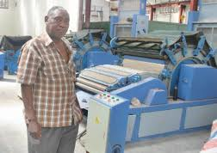
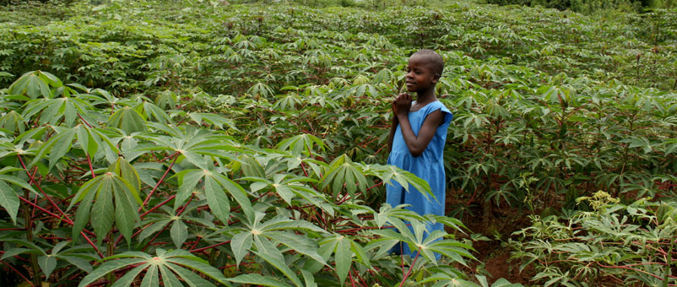
Income Generating Opportunities
Facilitate Trade and Investment

Slide 24
CONCLUSION
Mandate to coordinate SD of the Basin
The LVBC is well established
Has high level commitment from partner States

Slide 25
CONCLUSION
The Lake Victoria Basin is an
OCEAN OF OPPORTUNITIES
Partner With us to harness these opportunities

