Slide 1
LVBC Now and in the Future
East Africa Community
Lake Victoria Basin Commission
JUMUIYA YA AFRIKA MASHARIKI
Donors’ Conference
17th to 18th June, 2013
By
Dr. Canisius Kanangire
Executive Secretary, Lake Victoria Basin Commission

Slide 2
Discussion Highlight
Overview of the LVB – Some Facts and Figures
Opportunities in LVB
Major Challenges in LVB
LVBC legal basis and governance
The Shared Vision and Strategy Framework
Strategic Focus of the LBVC
Why Partner with LVBC
Future Outlook & Conclusion

Slide 3
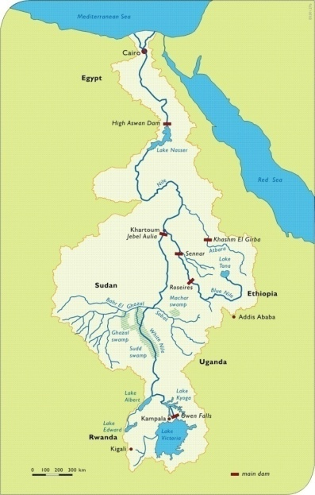

Slide 4





LVB Morphometric Data
Country | Flag | Lake Surface Area |  | Catchment Area |  | Lake Shoreline %
 |  | Sq Km | % | Sq Km | % | %
Tanzania |  | 35,124 | 51 | 79,570 | 44 | 33
Uganda |  | 29,613 | 43 | 28,857 | 15.9 | 50
Kenya |  | 4,113 | 6 | 38,913 | 21.5 | 17
Rwanda |  | - |  | 20,550 | 11.4 | 0
Burundi |  | - |  | 13,060 | 7.2 | 0
Total |  | 68,870 |  | 180,950 |  | 100

Slide 5
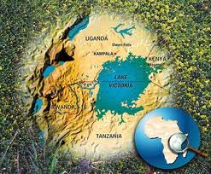
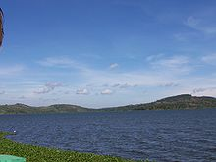
More facts about Lake Victoria
Parameter | Figures
Surface Area | 68,870 Km²
Average Depth | 40m
Maximum Depth | 84 Meters
Shore line length | 4828 Km
Volume | 2750 cubic Kilometers
Source of water | Precipitation- 82% Rivers – 18%
Loss of water | Evaporation – 76% River Nile Outflow – 24%
Water Residence Time | 23 Years
Flushing Time | 123 Years

Slide 6
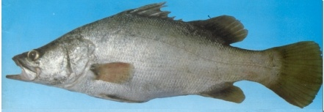
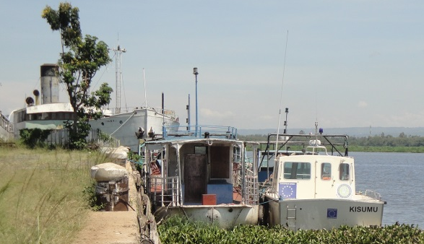
Opportunities in the LVB
Basins population 40 million
Largest inland fishing sanctuary
Major inland water transport linkage
Water Reservoir for Hydro Electric Power generation
Dilapidated and Hyacinth Chocked Kisumu Port

Slide 7
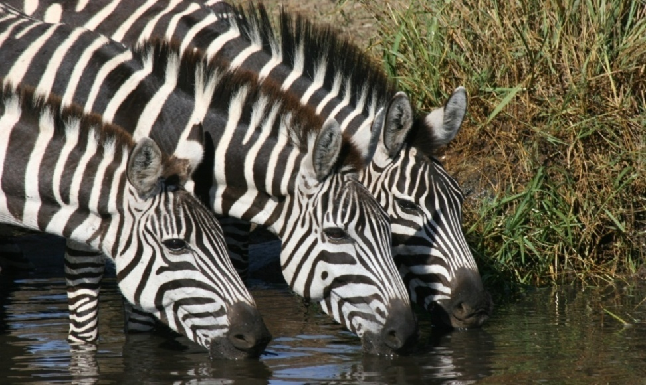
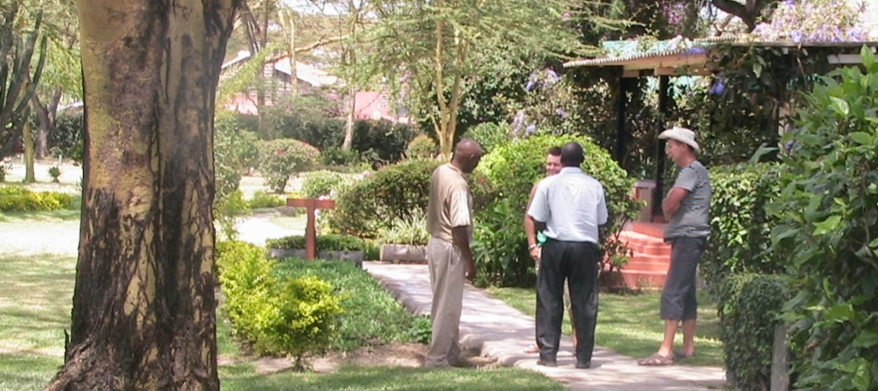
Opportunities in the LVB
Major source of water for domestic, Agric and industrial use
High Biodiversity reservoir - both aquatic and terrestrial flora & fauna
Wildlife resources & other tourist attractions

Slide 8
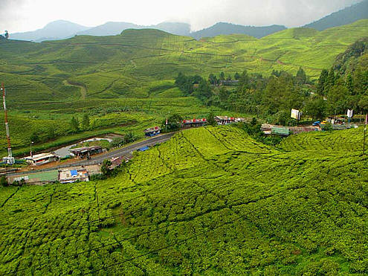
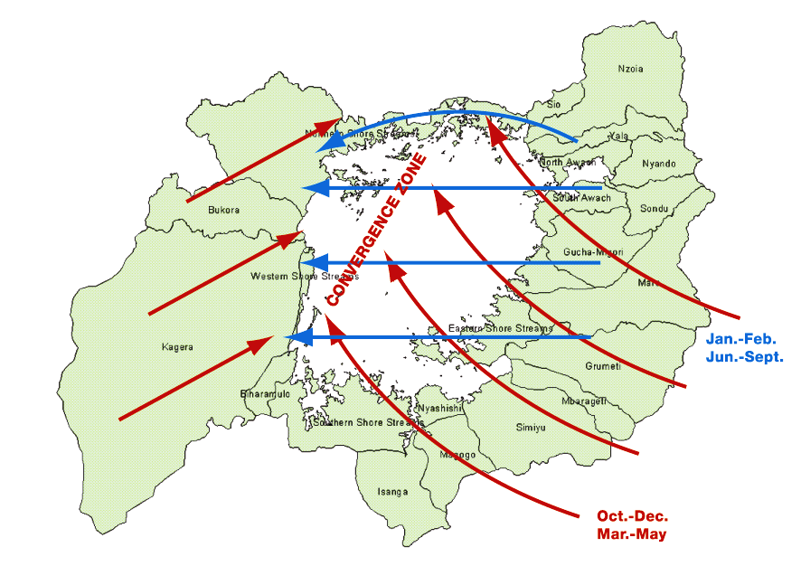
Opportunities in the LVB
Major climate modulator in the region
Fertile soils – huge agricultural potentials
Rich Minerals deposits – Gold and Diamonds

Slide 9
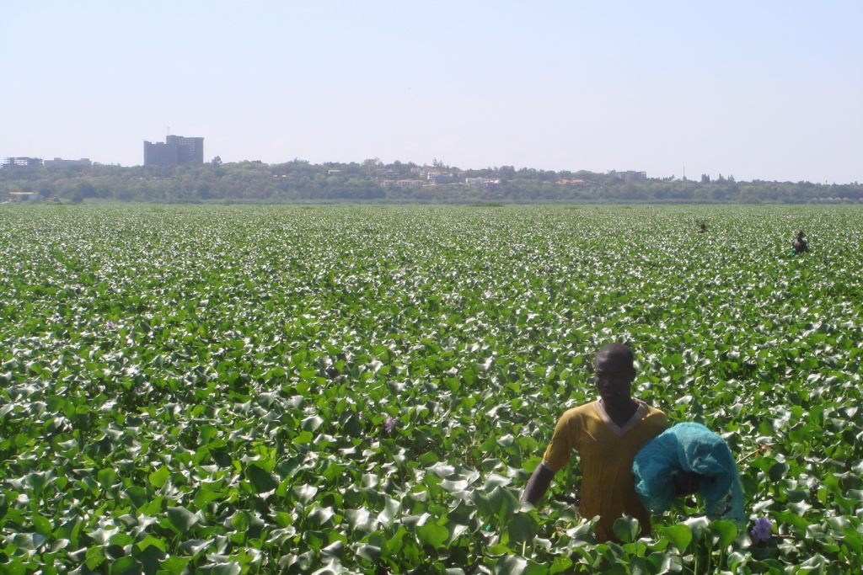
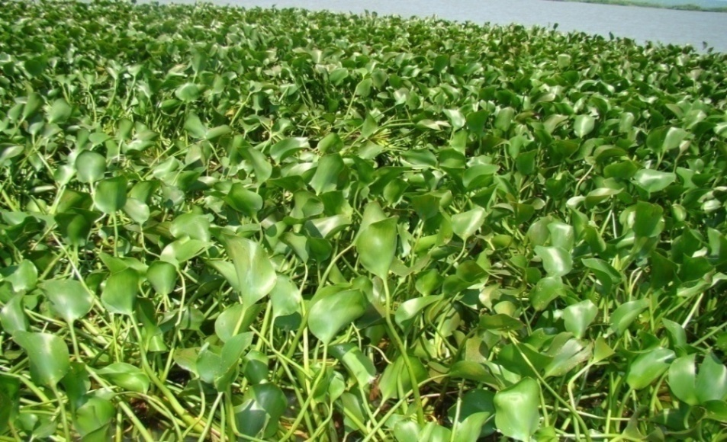
Environmental Stresses / Challenges in LVB
Stresses from the basin – e.g., land degradation, deforestation, water hyacinth, pollution from agro-chemicals, sediment loads, poor solid waste management
Stresses from outside the basin – e.g., nutrients (N and P) transported into the basin by air, climate change
Effects of Severe Eutrophication in Winam Gulf

Slide 10
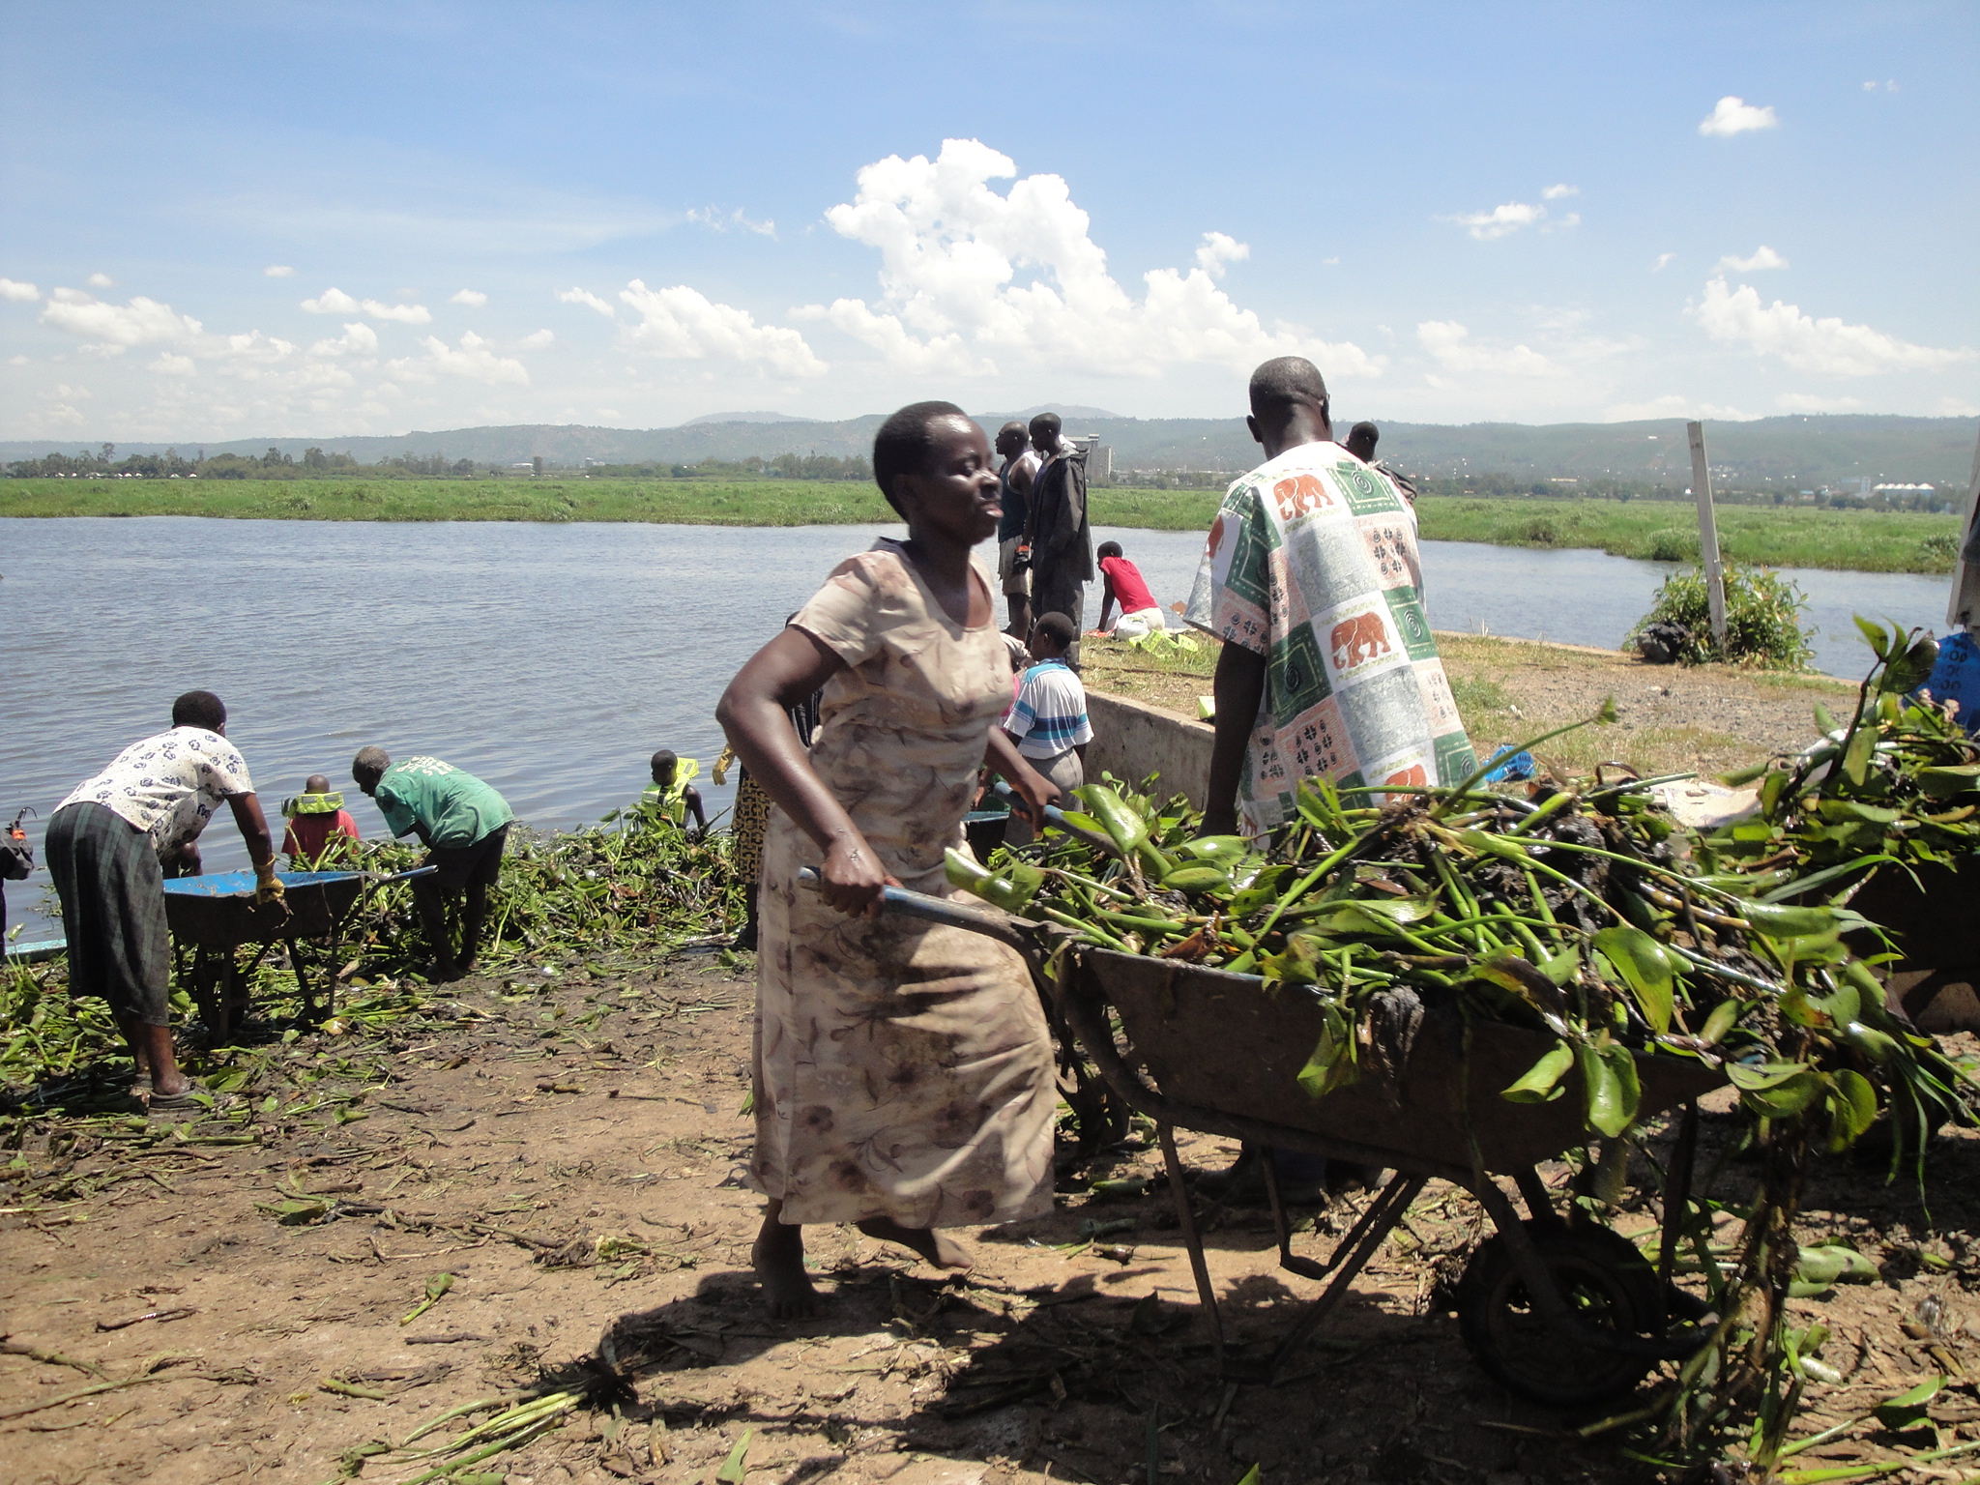
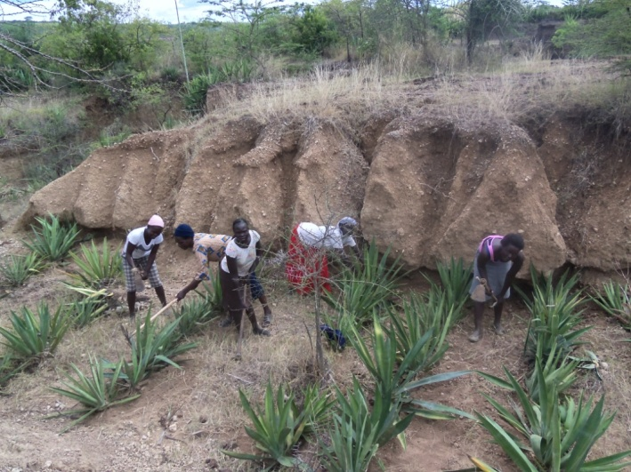
Environmental Stresses / Challenges in LVB
Stresses within the lake – e.g., over-fishing, oil spills, untreated liquid wastes, water hyacinth, over-abstraction of water from the lake and its basin
Stresses on littoral zones – e.g., construction and farming in shoreline, conversion of wetlands, poor solid wastes management

Slide 11
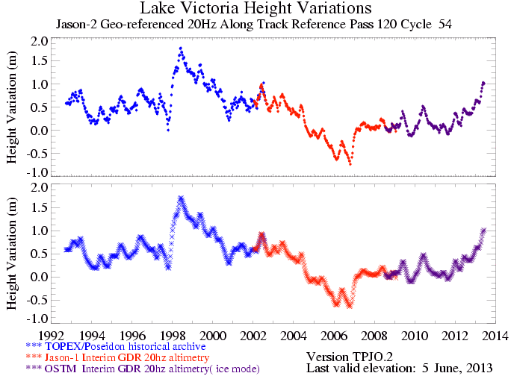
Fluctuations in Lake Levels

Slide 12
LVBC legal basis and governance
Institutional & Governance Instruments
Need for a regionally coordinated sustainable development.
The Treaty (1999)- Article 114, 2 b (vi) Partner States agreed to establish a body for the Management of Lake Victoria;
The Protocol for sustainable development of the basin signed in 2003 provides the legal and institutional framework for the much needed interventions

Slide 13
LVBC legal basis and governance
Institutional & Governance Instruments
Article 33 of the Protocol for Sustainable Development of Lake Victoria Basin establishes the LVBC, as an Institution of EAC;
Article 3 gives provision for the 14 areas that the Partner States have agreed to cooperate in sustainable conservation and use of resources within the Basin
The LVBC has a Sectoral Council of Ministers for LVB that provides policy direction on sustainable development of the LVB.

Slide 14
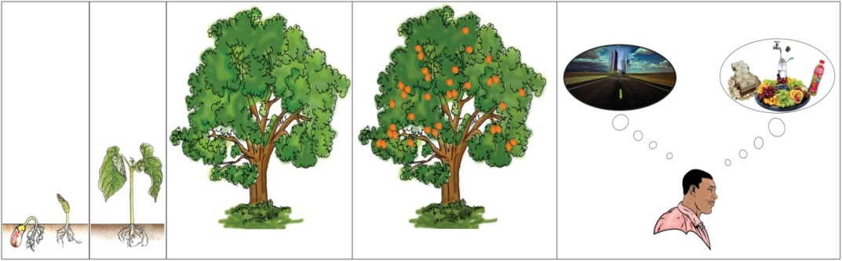
The Shared Vision
“A prosperous population living in a healthy and sustainably managed environment providing equitable opportunities & benefits”
The Shared Vision and Strategy framework for management and development of LVB is therefore the principal management instrument

Slide 15
The shared vision
It was developed between Nov 2001 and Aug 2003
In January 2004 – EAC Council of Ministers adopted the Shared Vision
The EAC Council recommended that Partner States, CSOs, Private Sector + other development Partners adopt it as a development guideline in sustainable management of LVB

Slide 16
Strategy framework for achieving the shared vision
The framework is premised on 5 policy areas:
Facilitating enhanced management of ecosystem, natural resources and a clean and healthy environment
Promoting production and income generation – resources are sustainably and equitably used for increased income and poverty reduction.
Improving living condition and quality of life – to ensure a healthy, well educated society with high quality of life and well developed infrastructure.

Slide 17
strategy framework for achieving the shared vision Cont’ed…..
Addressing population and demography – to ensure a healthy, competent and productive population with positive mindset to achieve economic growth and development.
Harmonization of Policies and strengthening of Institutions and governance- this ensures a well integrated institutional framework enabled by conducive policy environment that facilitates broader participation in management of resources.

Slide 18
What has been done: LVBC Projects & Programmes
POLICY AREA | PROGRAMMES/PROJECTS
1. ECOSYSTEM, NATURAL RESOURCES AND ENVIRONMENT | LVEMPII, MERECP, TWBHH-MRB, PREPARED
2. PRODUCTION AND INCOME GENERATION | PARTNERSHIP FUND, LVEMPII, MERECP
3. LIVING CONDITION AND QUALITY OF LIFE | EALP, LVWATSAN, MCSLV
4. POPULATION AND DEMOGRAPHY | EALP & PHE
5. POLICY, INSTITUTIONS AND GOVERNANCE | LVEMPII, PF, TWBHH-MRB, PREPARED

Slide 19
Strategic Focus to address gaps that still exist
Despite the ongoing interventions under the 7 projects and the Partnership fund, gaps still exist
More still needs to be done
Strategic planning at LVBC informs and will continue to inform interventions under future projects/programmes
The current Strategic Plan is for the period 2011/ 16

Slide 20
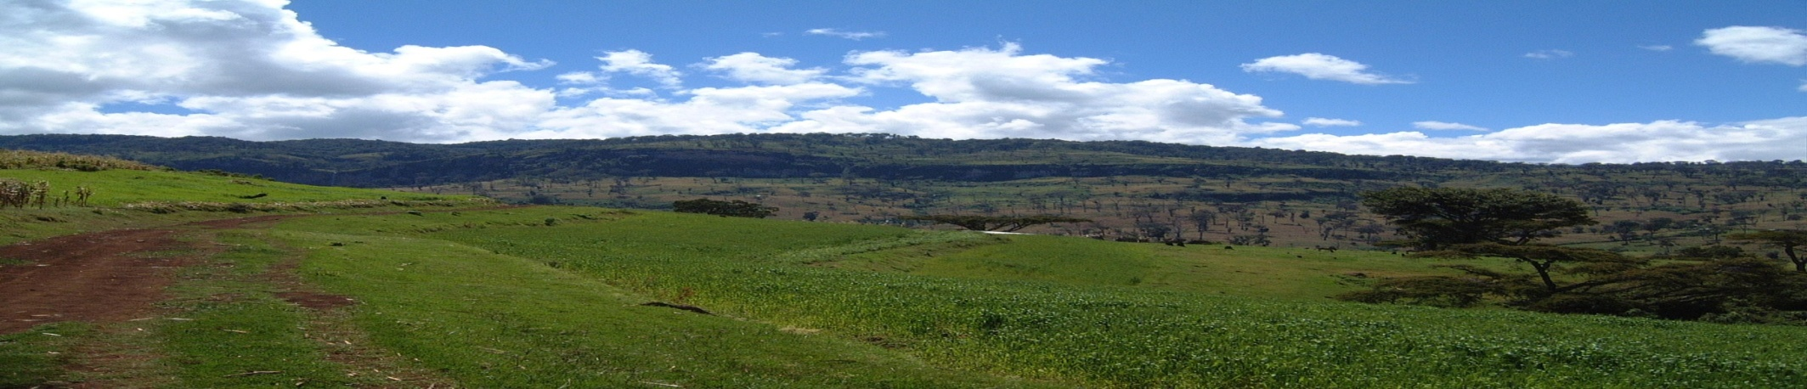
Development Objectives of the 2011-16
LVBC Strategic Plan
The objectives Include:
DO-1: To strengthen co-ordination and management capacity of the LVBC secretariat
DO-2: to enhance partnership and collaboration with key stakeholders
DO-3: To harmonize policies, regulations and standards and to strengthen institutional development and governance in NRM
Impact
Indicators
Outcomes
Outputs
Activities
Inputs
Results Logic Adopted to enhance performance and
Service delivery

Slide 21
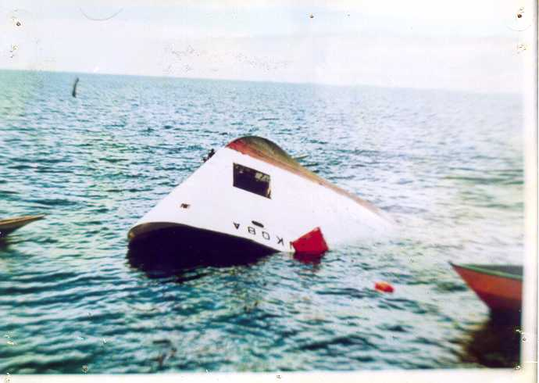
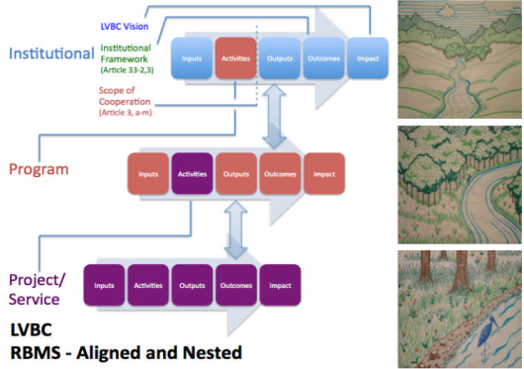
Development Objectives 2011-16 CONT,ED…
DO-4: to improve public health services with emphasis on HIV/AIDS; reproductive health; water and sanitation and nutrition status
DO-5: to improve safety of navigation and security on Lake Victoria
DO-6: To enhance management of ecosystems, natural resources including climate change adaptation and mitigation strategies
DO-7: To promote investment, infrastructure development and sustainable livelihood
MV Bukoba that capsized in 1996 killing about 800 people
Schematic Illustration of the Results Based Management Framework of LVBC

Slide 22
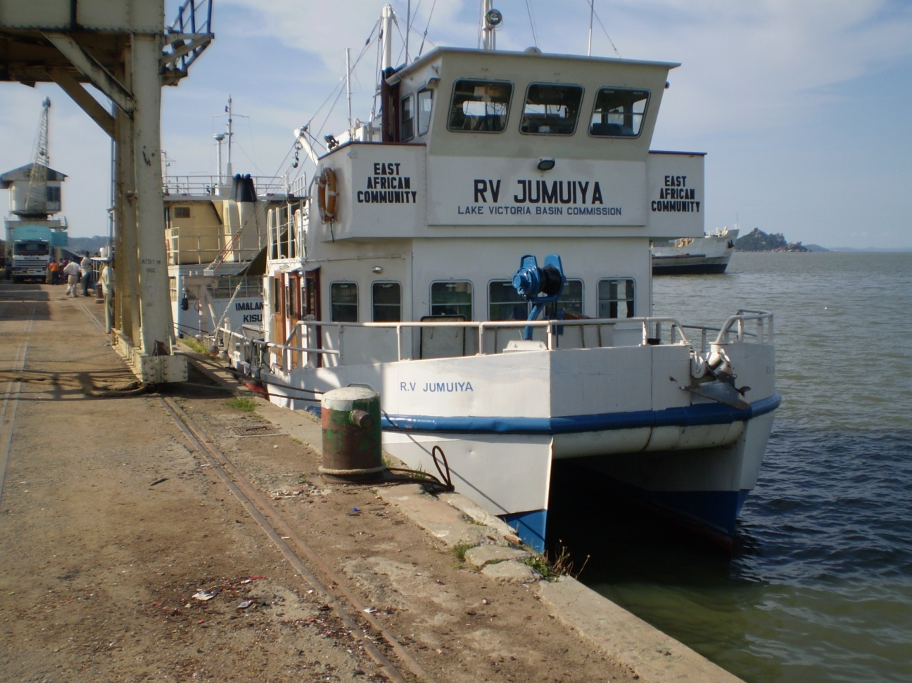
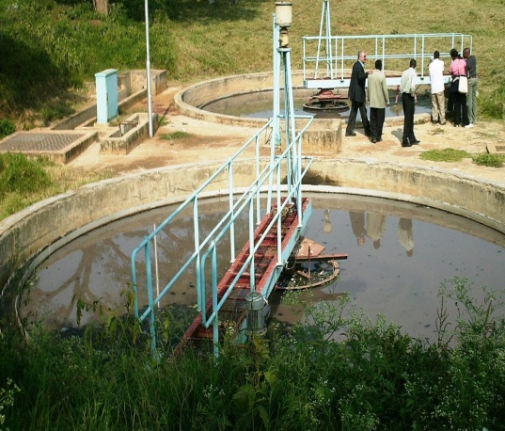
Commission’s future outlook
Based on the LVBC Strategic Plan (2011 – 2016), the key strategic areas of future focus include:
Investment and infrastructure development projects
    Water supply and sanitation
    Water for food security
    Maritime transport
    Integrated watershed management

Slide 23
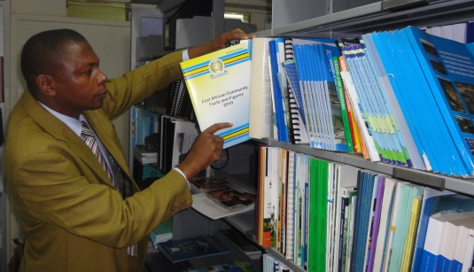
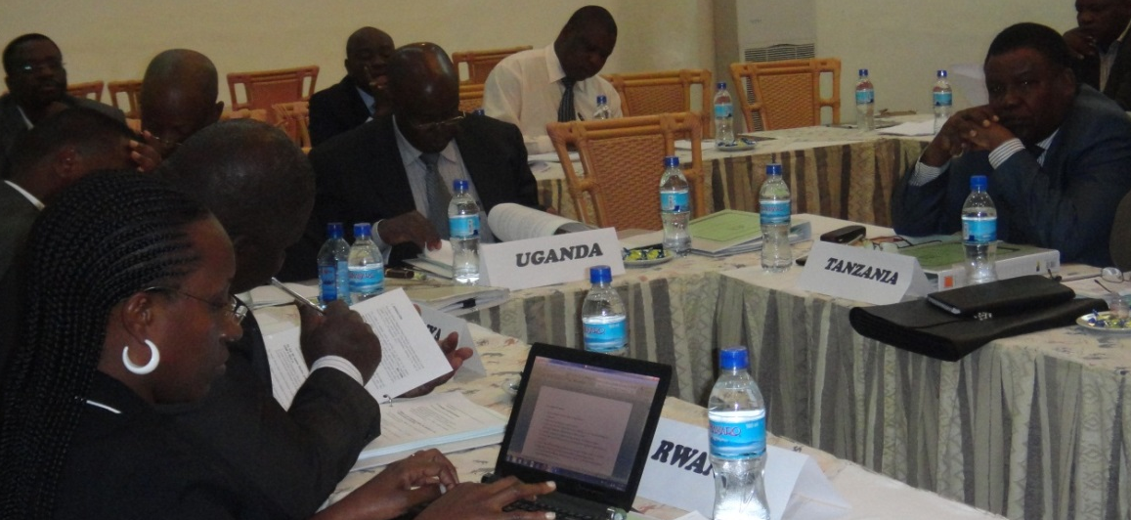
Commission’s future outlook
Future focus
2. Knowledge management, data and information sharing
Leveraging on technological innovations for ecosystem management
Sustainable management of transboundary natural resources
Stakeholders coordination and creation of synergies
LVBC’s Resource Centre

Slide 24
Why Partner with LVBC?
Founded on sound Intergovernmental Legal and Policy Framework
Comprehensive institutional and governance structure
Political goodwill and support from the five (5) EAC Partner States
Clear strategic focus
Broad Spectrum of stakeholders participation and involvement
Over SEVEN (7) YEARS experience in management of transboundary ecosystems

Slide 25
CONCLUSION
The use of a programmatic approach in the sustainable management of LVB provides a clear framework for development of the Basin in line with the Shared Vision and Strategic Framework.
Management of shared natural resources requires wisdom, stakeholder involvement and participation in order to establish confidence and minimize conflicts while realizing maximum benefits for the communities
LVBC enjoys the trust and support from EAC Partner States, stakeholders & development partners and can effectively deliver
We therefore invite you to Partner with us

Slide 26
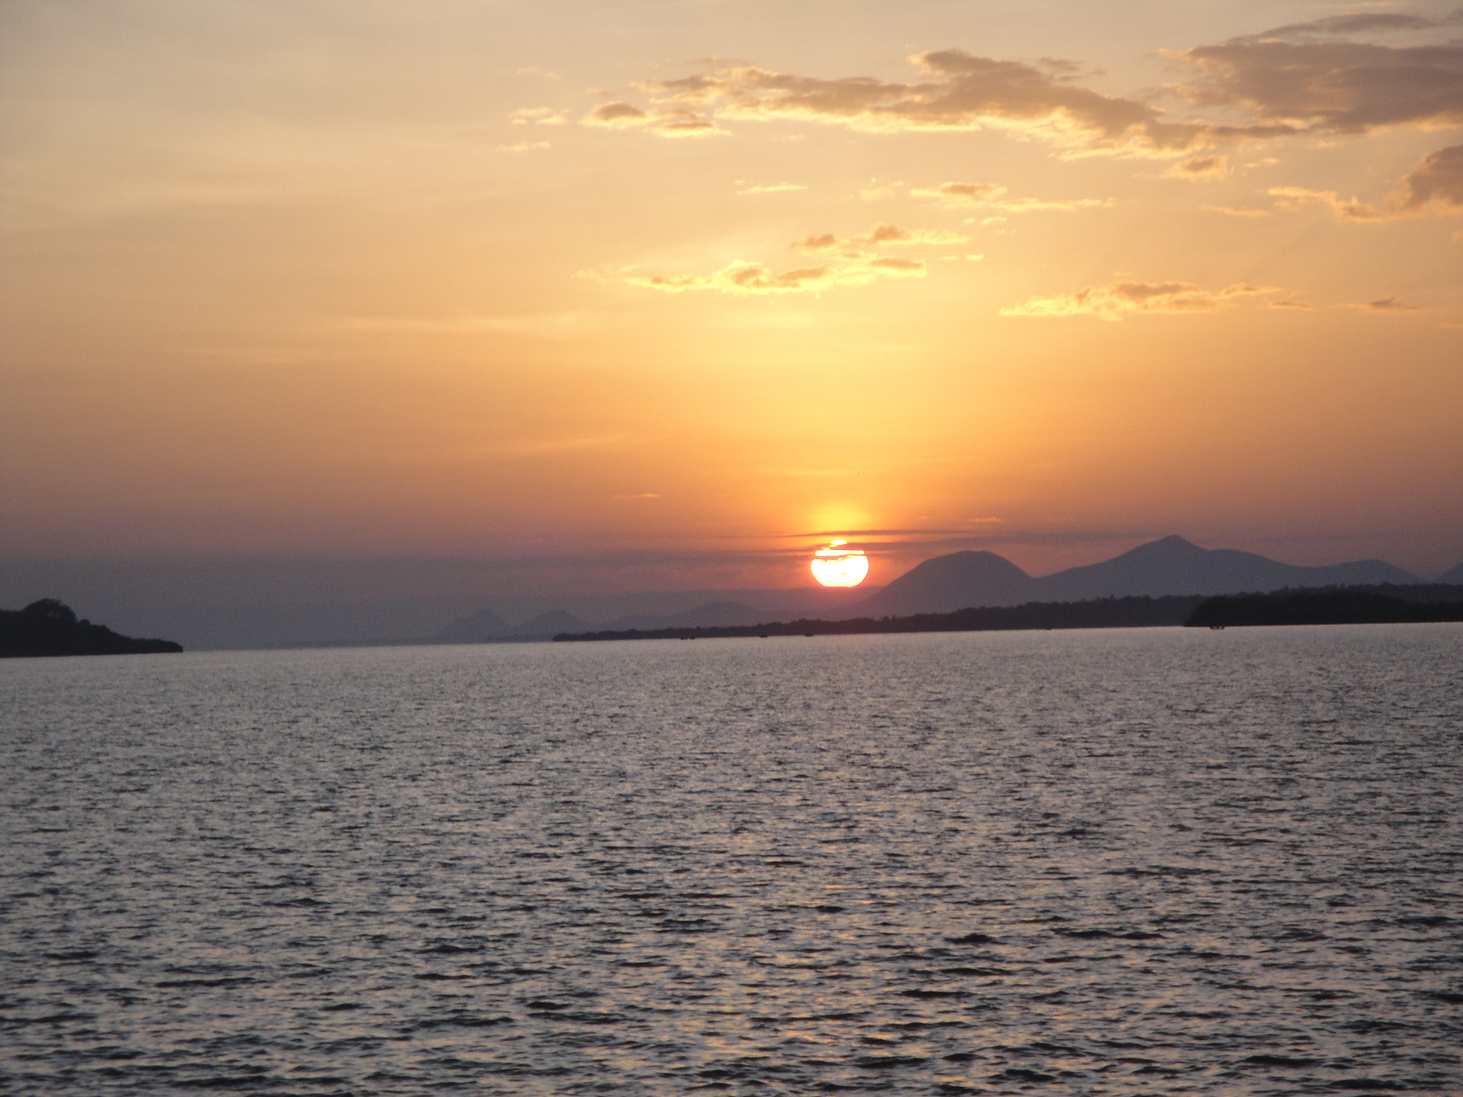
Thank You

